Slide 1
Optimizing Locking Operations
Anju munoth

Slide 2
What are MySQL Locks?
A MySQL Locks is nothing but a flag that can be assigned to a table to alter its properties.
MySQL allows a table lock that can be assigned by a client-server to prevent other sessions from being able to access the same table during a specific time frame.
A client can acquire or release MySQL Locks only for his session.
This means that locks for another session or release locks held by another session cannot be accessed by the client.

Slide 3
Locks in mysql
MySQL manages contention for table contents using locking:
Internal locking is performed within the MySQL server itself to manage contention for table contents by multiple threads.
This type of locking is internal because it is performed entirely by the server and involves no other programs.
External locking occurs when the server and other programs lock MyISAM table files to coordinate among themselves which program can access the tables at which time.

Slide 4
Lock tables
LOCK Tables for current client sessions can acquire locks only when declared explicitly.
Base tables or views also support the use of locks.
For utilizing the locks and objects to be locked you must have LOCK Tables privileges and Select Privileges.
As soon as you lock a table using the Lock table any tables used in triggers are also locked implicitly.
Any tables related by a foreign key constraint are opened and locked implicitly.
For consecutive shared-nothing WRITE, the lock is taken on related tables that are involved in the operation.
To acquire table locks within the current session, use the Lock Table statement, which acquires metadata locks.

Slide 5
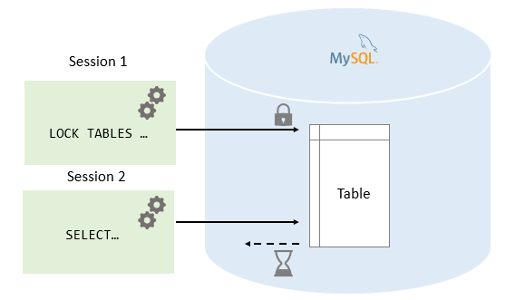

Slide 6
MySQL Locks
Syntax
LOCK TABLES
table_name [[AS] alias] lock_type
[, tbl_name [[AS] alias] lock_type] ...

Slide 7
Types of MySQL Locks?
MySQL Locks: Read Locks
MySQL Locks: Write Locks

Slide 8
MySQL Locks: Read Locks
MySQL allows multiple sessions to be in READ lock for a table concurrently.
And it also allows for other sessions to read the table without acquiring the lock.
If the session holds the READ lock on a table, they cannot perform a write operation on it.
It is because the READ lock can only read data from the table.
All other sessions that do not acquire a READ lock are not able to write data into the table without releasing the READ lock.
The write operations go into the waiting states until we have not released the READ lock.
When the session is terminated normally or abnormally, MySQL implicitly releases all types of locks onto the table. This feature is also relevant for the WRITE lock

Slide 9
MySQL Locks: Write Locks
It is the session that holds the lock of a table and can read and write data both from the table.
It is the only session that accesses the table by holding a lock.
And all other sessions cannot access the data of the table until the WRITE lock is released.

Slide 10
READ [LOCAL] lock:
The session that holds the lock can read the table but not write it.
Multiple sessions can acquire a READ lock for the table at the same time.
Other sessions can read the table without explicitly acquiring a READ lock.
The LOCAL modifier enables nonconflicting INSERT statements (concurrent inserts) by other sessions to execute while the lock is held.
However, READ LOCAL cannot be used if you are going to manipulate the database using processes external to the server while you hold the lock.

Slide 11
[LOW_PRIORITY] WRITE lock:
The session that holds the lock can read and write the table.
Only the session that holds the lock can access the table. No other session can access it until the lock is released.
Lock requests for the table by other sessions block while the WRITE lock is held.
The LOW_PRIORITY modifier has no effect. In previous versions of MySQL, it affected locking behavior, but this is no longer true.
It is now deprecated and its use produces a warning.

Slide 12
Write locks
WRITE locks have higher priority when compared to READ locks to ensure that updates are processed asap.
This means that if a session has obtained a READ lock and simultaneously another session requests a WRITE lock, the session with READ lock requests has to wait until the session that requested the WRITE the lock has obtained the lock and released it.
If MySQL Locks Table statement must wait due to locks held by other sessions on any of the tables, it blocks until all locks can be acquired.
A session that requires locks must acquire all the locks that it needs in a single Lock statement. While the locks thus obtained are held, the session can access only the locked tables

Slide 13
Unlock the table in MySQL
When the MySQL locks held by a session get released, they are all released at the same time.
A session might release its locks explicitly, or it might be released implicitly under certain conditions.
If a session issues a LOCK TABLES statement to acquire a lock while already holding MySQL locks, its existing locks are released implicitly before the new locks get granted.
A session can release its locks explicitly with the help of UNLOCK TABLES.
If a session begins a transaction, an implicit UNLOCK TABLES is performed, which causes existing MySQL locks to be released.
If the connection for a client session gets terminated, whether normally or abnormally, the server will implicitly release all MySQL locks held by the session, If the client reconnects, the MySQL locks are no longer in effect

Slide 14
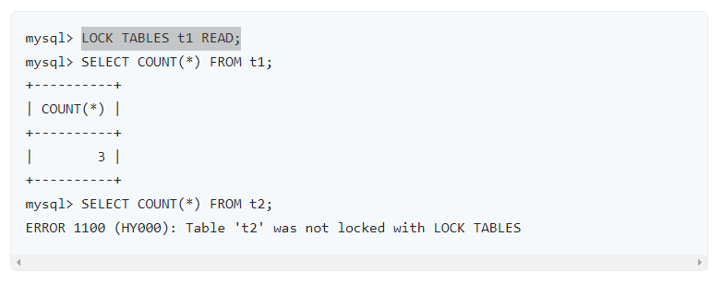

Slide 15
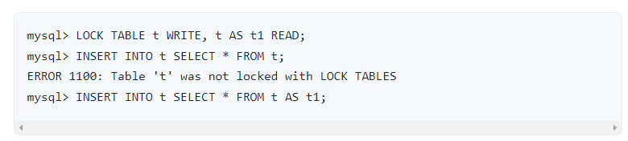
Locks cannot be accessed multiple times with the same name. Multiple aliases can be used with the same name to overcome this issue.
The error occurs for the first INSERT because there are two references to the same name for a locked table.
The second INSERT succeeds because the references to the table use different names.

Slide 16
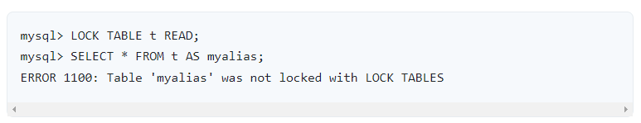
If your statements refer to a table by means of an alias, you must lock the table using that same alias.

Slide 17
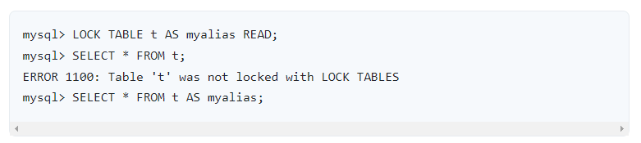
On locking a table using an alias, must refer to it in your statements using that alias

Slide 18
MySQL UNLOCK TABLES statement
To release a lock for a table, you use the following UNLOCK TABLES statement:
UNLOCK TABLES;

Slide 19
Read vs. Write locks
Read locks are “shared” locks that prevent a write lock is being acquired but not other read locks.
Write locks are “exclusive ” locks that prevent any other lock of any kind.

Slide 20
Table Locking and Transactions
UNLOCK TABLES implicitly commits any active transaction, but only if LOCK TABLES have been used to acquire table locks.
For instance, in the following set of statements, UNLOCK TABLES releases the global read lock but doesn’t commit the transaction because no table locks are in effect:
FLUSH TABLES WITH READ LOCK;
START TRANSACTION;
SELECT ... ;
UNLOCK TABLES;

Slide 21
Table Locking and Transactions
LOCK TABLES is not transaction-safe and implicitly commit any active transaction before attempting to lock the tables.
Beginning a transaction, for instance, START TRANSACTION implicitly commits any current transaction and releases existing MySQL locks.
FLUSH TABLES WITH READ LOCK acquires a global read lock instead of table locks, therefore, it is not subject to the same behavior as UNLOCK TABLES and LOCK TABLES with respect to table locking and implicit commits.
ROLLBACK doesn’t release table locks.
Other statements that implicitly cause transactions to be committed do not release existing table locks.
The right way to use UNLOCK TABLES and LOCK TABLES with transactional tables, such as InnoDB tables, is to start a transaction with SET autocommit = 0 (not START TRANSACTION) followed by LOCK TABLES and to not call UNLOCK TABLES until you commit the transaction explicitly.

Slide 22
Table Locking and Transactions
For instance, if you need to write table t1 and read from table t2, you can execute this:
SET autocommit=0;
LOCK TABLES t1 WRITE, t2 READ, ...;
... do something with tables t1 and t2 here ...
COMMIT;
UNLOCK TABLES;
When you summon LOCK TABLES, InnoDB internally takes its own table lock, and MySQL takes its own MySQL lock.
InnoDB releases its internal table lock at the next commit, but for MySQL to release its table lock, you have to summon UNLOCK TABLES.
You should not have autocommit = 1, because then InnoDB releases its internal table lock immediately after the call of LOCK TABLES, and deadlocks can very easily happen.
InnoDB does not acquire the internal table lock at all if autocommit = 1, to help old applications avoid unnecessary deadlocks

Slide 23
Internal Locking Methods
Locking performed within the MySQL server itself to manage contention for table contents by multiple sessions.
This type of locking is internal because it is performed entirely by the server and involves no other programs.

Slide 24
Row-Level Locking
MySQL uses row-level locking for InnoDB tables to support simultaneous write access by multiple sessions, making them suitable for multi-user, highly concurrent, and OLTP applications.
To avoid deadlocks when performing multiple concurrent write operations on a single InnoDB table, acquire necessary locks at the start of the transaction by issuing a SELECT ... FOR UPDATE statement for each group of rows expected to be modified, even if the data change statements come later in the transaction.
If transactions modify or lock more than one table, issue the applicable statements in the same order within each transaction.
Deadlocks affect performance rather than representing a serious error, because InnoDB automatically detects deadlock conditions by default and rolls back one of the affected transactions.
On high concurrency systems, deadlock detection can cause a slowdown when numerous threads wait for the same lock.
At times, it may be more efficient to disable deadlock detection and rely on the innodb_lock_wait_timeout setting for transaction rollback when a deadlock occurs.
Deadlock detection can be disabled using the innodb_deadlock_detect configuration option.

Slide 25
Advantages of row-level locking:
Fewer lock conflicts when different sessions access different rows.
Fewer changes for rollbacks.
Possible to lock a single row for a long time.

Slide 26
Table-Level Locking
MySQL uses table-level locking for MyISAM, MEMORY, and MERGE tables, permitting only one session to update those tables at a time.
This locking level makes these storage engines more suitable for read-only, read-mostly, or single-user applications.
These storage engines avoid deadlocks by always requesting all needed locks at once at the beginning of a query and always locking the tables in the same order.
Tradeoff is that this strategy reduces concurrency; other sessions that want to modify the table must wait until the current data change statement finishes.

Slide 27
Advantages of table-level locking:
Relatively little memory required (row locking requires memory per row or group of rows locked)
Fast when used on a large part of the table because only a single lock is involved.
Fast if you often do GROUP BY operations on a large part of the data or must scan the entire table frequently.

Slide 28
Table-Level Locking
MySQL grants table write locks as follows:
If there are no locks on the table, put a write lock on it.
Otherwise, put the lock request in the write lock queue.
MySQL grants table read locks as follows:
If there are no write locks on the table, put a read lock on it.
Otherwise, put the lock request in the read lock queue.

Slide 29
Table-Level Locking
Table updates are given higher priority than table retrievals.
Therefore, when a lock is released, the lock is made available to the requests in the write lock queue and then to the requests in the read lock queue.
This ensures that updates to a table are not “starved” even when there is heavy SELECT activity for the table.
However, if there are many updates for a table, SELECT statements wait until there are no more updates.
Can analyze the table lock contention on your system by checking the Table_locks_immediate and Table_locks_waited status variables, which indicate the number of times that requests for table locks could be granted immediately and the number that had to wait, respectively:

Slide 30
Table-Level Locking
mysql> SHOW STATUS LIKE 'Table%';
+-----------------------+---------+
| Variable_name | Value |
+-----------------------+---------+
| Table_locks_immediate | 1151552 |
| Table_locks_waited | 15324 |
+-----------------------+---------+

Slide 31
Choosing the Type of Locking
Generally, table locks are superior to row-level locks in the following cases:
Most statements for the table are reads.
Statements for the table are a mix of reads and writes, where writes are updates or deletes for a single row that can be fetched with one key read:
UPDATE tbl_name SET column=value WHERE unique_key_col=key_value;
DELETE FROM tbl_name WHERE unique_key_col=key_value;
SELECT combined with concurrent INSERT statements, and very few UPDATE or DELETE statements.
Many scans or GROUP BY operations on the entire table without any writers.

Slide 32
Options other than row-level locking:
Versioning (such as that used in MySQL for concurrent inserts) where it is possible to have one writer at the same time as many readers.
This means that the database or table supports different views for the data depending on when access begins. Other common terms for this are “time travel,” “copy on write,” or “copy on demand.”
Copy on demand is in many cases superior to row-level locking. However, in the worst case, it can use much more memory than using normal locks.
Instead of using row-level locks, you can employ application-level locks, such as those provided by GET_LOCK() and RELEASE_LOCK() in MySQL. These are advisory locks, so they work only with applications that cooperate with each other

Slide 33
Metadata Locking
MySQL uses metadata locking to manage concurrent access to database objects and to ensure data consistency.
Metadata locking applies not just to tables, but also to schemas, stored programs (procedures, functions, triggers, scheduled events), tablespaces, user locks acquired with the GET_LOCK() function
The Performance Schema metadata_locks table exposes metadata lock information, which can be useful for seeing which sessions hold locks, are blocked waiting for locks, and so forth.
Metadata locking does involve some overhead, which increases as query volume increases.
Metadata contention increases the more that multiple queries attempt to access the same objects.
Metadata locking is not a replacement for the table definition cache, and its mutexes and locks differ from the LOCK_open mutex.

Slide 34
Metadata Lock Acquisition
If there are multiple waiters for a given lock, the highest-priority lock request is satisfied first, with an exception related to the max_write_lock_count system variable.
Write lock requests have higher priority than read lock requests.
However, if max_write_lock_count is set to some low value (say, 10), read lock requests may be preferred over pending write lock requests if the read lock requests have already been passed over in favor of 10 write lock requests.
Normally this behavior does not occur because max_write_lock_count by default has a very large value.
Statements acquire metadata locks one by one, not simultaneously, and perform deadlock detection in the process.
DML statements normally acquire locks in the order in which tables are mentioned in the statement.

Slide 35
metadata_locks Table
MySQL uses metadata locking to manage concurrent access to database objects and to ensure data consistency;
Metadata locking applies not just to tables, but also to schemas, stored programs (procedures, functions, triggers, scheduled events), tablespaces, user locks acquired with the GET_LOCK() function
SELECT * FROM performance_schema.metadata_locks\G

Slide 36
metadata_locks Table
Performance Schema exposes metadata lock information through the metadata_locks table:
Locks that have been granted (shows which sessions own which current metadata locks).
Locks that have been requested but not yet granted (shows which sessions are waiting for which metadata locks).
Lock requests that have been killed by the deadlock detector.
Lock requests that have timed out and are waiting for the requesting session's lock request to be discarded

Slide 37
metadata_locks Table
This information enables you to understand metadata lock dependencies between sessions.
You can see not only which lock a session is waiting for, but which session currently holds that lock.
The metadata_locks table is read only and cannot be updated.
It is autosized by default; to configure the table size, set the performance_schema_max_metadata_locks system variable at server startup

Slide 38
metadata_locks Table
Performance Schema maintains metadata_locks table content as follows, using the LOCK_STATUS column to indicate the status of each lock
When a metadata lock is requested and obtained immediately, a row with a status of GRANTED is inserted.
When a metadata lock is requested and not obtained immediately, a row with a status of PENDING is inserted.
When a metadata lock previously requested is granted, its row status is updated to GRANTED.
When a metadata lock is released, its row is deleted.
When a pending lock request is canceled by the deadlock detector to break a deadlock (ER_LOCK_DEADLOCK), its row status is updated from PENDING to VICTIM.
When a pending lock request times out (ER_LOCK_WAIT_TIMEOUT), its row status is updated from PENDING to TIMEOUT.

Slide 39
metadata_locks Table
Performance Schema maintains metadata_locks table content as follows, using the LOCK_STATUS column to indicate the status of each lock
When granted lock or pending lock request is killed, its row status is updated from GRANTED or PENDING to KILLED.
The VICTIM, TIMEOUT, and KILLED status values are brief and signify that the lock row is about to be deleted.
The PRE_ACQUIRE_NOTIFY and POST_RELEASE_NOTIFY status values are brief and signify that the metadata locking subsubsystem is notifying interested storage engines while entering lock acquisition operations or leaving lock release operations.

Slide 40
table_handles Table
SELECT * FROM performance_schema.table_handles\G
Performance Schema exposes table lock information through the table_handles table to show the table locks currently in effect for each opened table handle. table_handles reports what is recorded by the table lock instrumentation.
This information shows which table handles the server has open, how they are locked, and by which sessions.
The table_handles table is read only and cannot be updated.
It is autosized by default; to configure the table size, set the performance_schema_max_table_handles system variable at server startup.

Slide 41
Avoiding Deadlocks
DDL statements, LOCK TABLES, and other similar statements try to reduce the number of possible deadlocks between concurrent DDL statements by acquiring locks on explicitly named tables in name order.
Locks might be acquired in a different order for implicitly used tables (such as tables in foreign key relationships that also must be locked).

Slide 42
MySQL Table Locking Restrictions and Conditions?
Can leverage KILL to terminate a session that is waiting for a table lock.
UNLOCK TABLES and LOCK TABLES cannot be used within stored programs.
Tables present in the performance_schema database cannot be locked with LOCK TABLES, except the setup_xxx tables.
The scope of a MySQL lock generated by LOCK TABLES is a single MySQL server.
MySQL Locks aren’t compatible with the NDB cluster, which has no way of enforcing an SQL-level across various instances of mysqlId.
The following statements are prohibited while a LOCK TABLES statement is in effect: CREATE VIEW, DROP VIEW, CREATE TABLE, CREATE TABLE … LIKE, along with DDL statements on stored functions and events and procedures.

Slide 43
MySQL Table Locking Restrictions and Conditions?
Usually, you don’t need to lock tables, because all the single UPDATE statements are atomic, so, no other session can interfere with any other currently executing SQL statement.
If you are using tables for a nontransactional storage engine, you will have to use LOCK TABLES to ensure that no other session modifies the tables between a SELECT and an UPDATE.
If you are going to run various operations on a set of MyISAM tables, it is much faster to lock the tables you are going to use.
Locking MyISAM tables will speed up updating, inserting, or deleting them because MySQL does not flush the key cache for the locked tables until UNLOCK TABLES is called.

Slide 44
Lost Update anomaly
Let’s consider the Lost Update anomaly, which can happen on any database running under the Read Committed isolation level
Alice reads the account balance, and the value is 50.
Right afterward, Bob changes the account balance from 50 to 20 and commits.
Alice’s transaction is still running, and thinking that the account balance is still 50, she withdraws 40 thinking that the final balance will be 10.
However, since the valance has changed, Alice’s UPDATE is going to leave the account balance in a negative value.
This transaction schedule is not Serializable because it’s neither equivalent to Alice’s reads and writes followed by Bob’s read and writes or Bob executing his transaction first followed by Alice executing her transaction right after.
The reads and the writes are interleaves, and that’s why the Lost Update anomaly is generated.

Slide 45
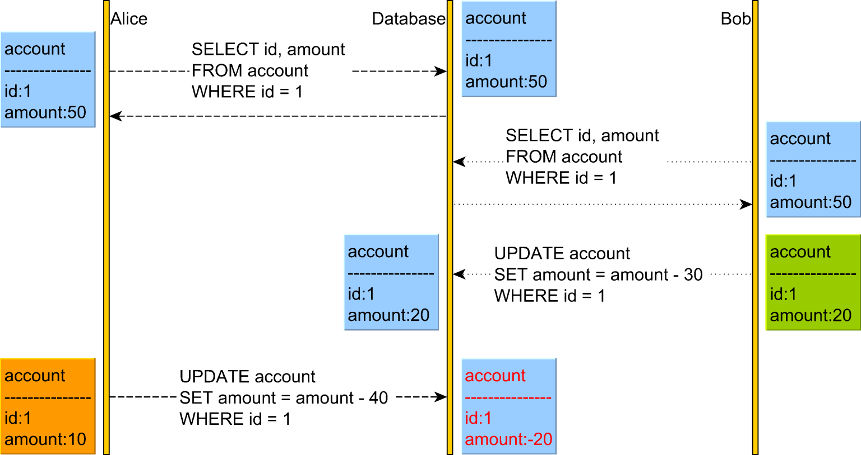
Lost Update anomaly

Slide 46
Pessimistic Locking
both Alice and Bob will acquire a read (shared) lock on the account table row upon reading it.
Because both Alice and Bob hold the read (shared) lock on the account record with the identifier value of 1, neither of them can change it until one releases the read lock they acquired.
This is because a write operation requires a write (exclusive) lock acquisition, and read (shared) locks prevent write (exclusive) locks.
For this reason, Bob’s UPDATE blocks until Alice releases the shared lock she has acquired previously.

Slide 47
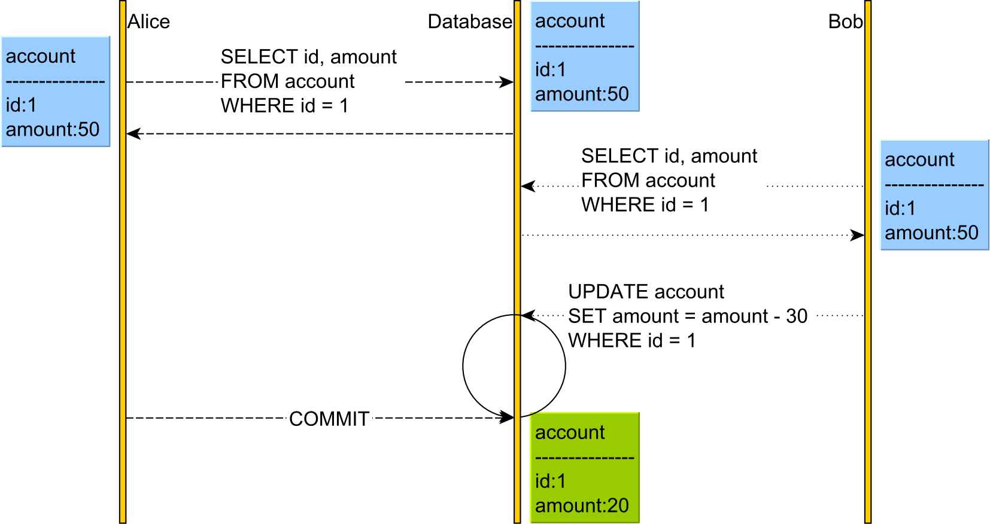

Slide 48
Optimistic Locking
Optimistic Locking allows a conflict to occur, but it needs to detect it at write time.
This can be done using either a physical or a logical clock.
However, since logical clocks are superior to physical clocks when it comes to implementing a concurrency control mechanism, we are going to use a version column to capture the read-time row snapshot information.
The version column is going to be incremented every time an UPDATE or DELETE statement is executed while also being used for matching the expected row snapshot in the WHERE clause.

Slide 49
Optimistic Locking
So, when reading the account record, both users read its current version.
However, when Bob changes the account balance, he also changes the version from 1 to 2.
Afterward, when Alice wants to change the account balance, her UPDATE statement will not match any record since the version column value is no longer 1, but 2.
Therefore, the executeUpdate method of the UPDATE PreapredStatement is going to return a value of 0, meaning that no record was changed, and the underlying data access framework will throw an OptimisticLockException that will cause Alice’s transaction to rollback.
So, the Lost Update is prevented by rolling back the subsequent transactions that are operating on state data.

Slide 50
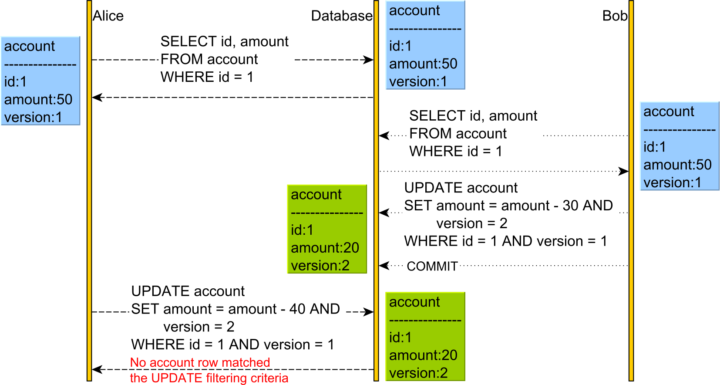

Slide 51
Pessimistic vs optimistic
Both pessimistic and optimistic locking are useful techniques.
Pessimistic locking is suitable when the cost of retrying a transaction is very high or when contention is so large that many transactions would end up rolling back if optimistic locking were used.
On the other hand, optimistic locking works even across multiple database transactions since it doesn’t rely on locking physical records.

